Slide 1
Syntax Analysis
Bottom Up Parsing

Slide 2
Bottom-Up Parsing
Bottom-up parsing parses the input string from the lexical analyzer. And if there is no error in the input string it constructs a parse tree as output. The bottom-up parsing starts building parse trees from the leaf nodes i.e., from the bottom of the tree. And gradually proceeds upwards to the root of the parse tree.
The bottom-up parsers are created for the largest class of LR grammars. As the bottom-up parsing corresponds to the process of reducing the string to the starting symbol of the grammar.
Step of Reducing a String:
A specific substring from the input string is identified.
A non-terminal in a grammar whose production body matches the substring is identified.
The substring in the input string is replaced by the non-terminal identified in step 2.
The main problem of bottom-up parsing is to decide:
When to reduce which substring from the input string.
Which production from the grammar must be applied.
The reduction process in the bottom Up parsing is just the right most derivation in reverse order

Slide 3
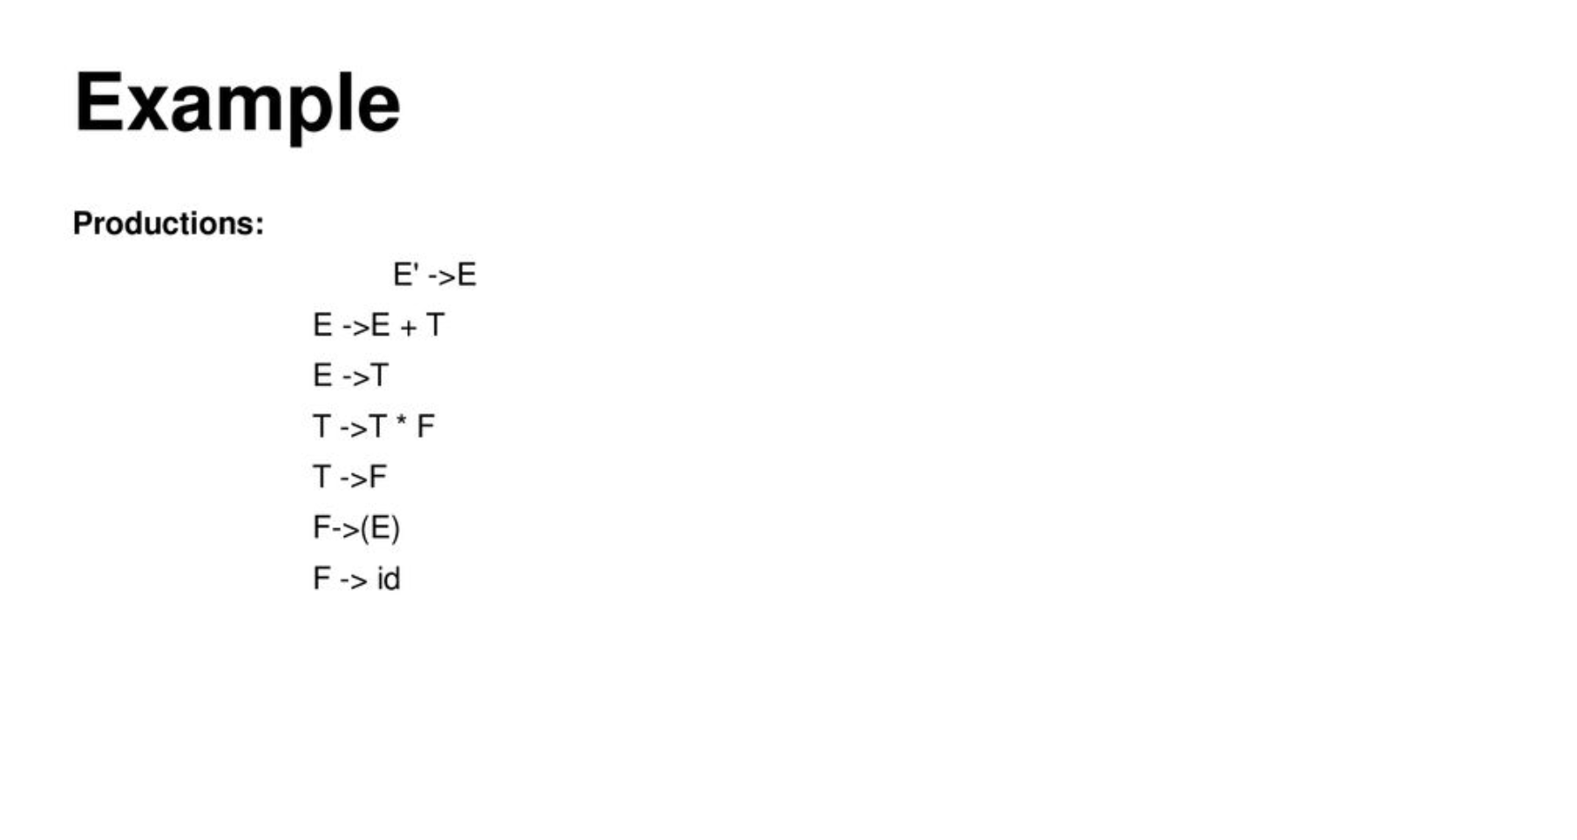

Slide 4
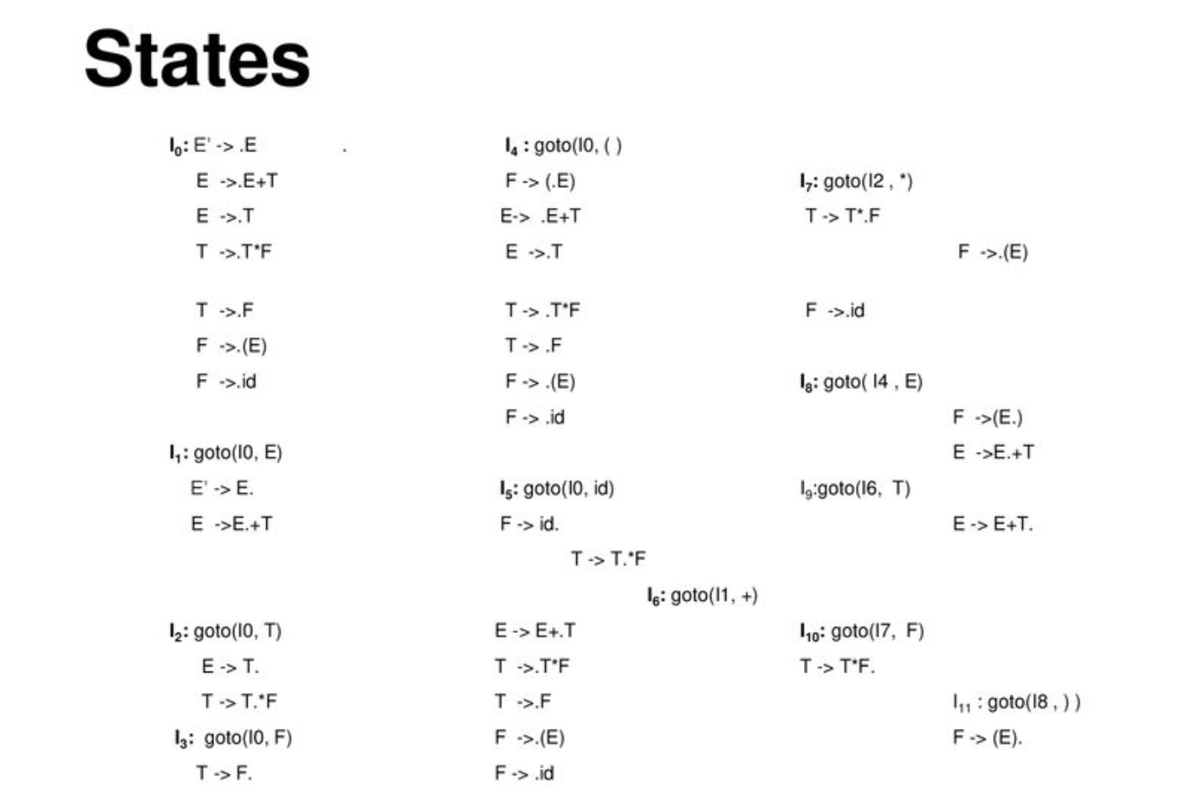

Slide 5
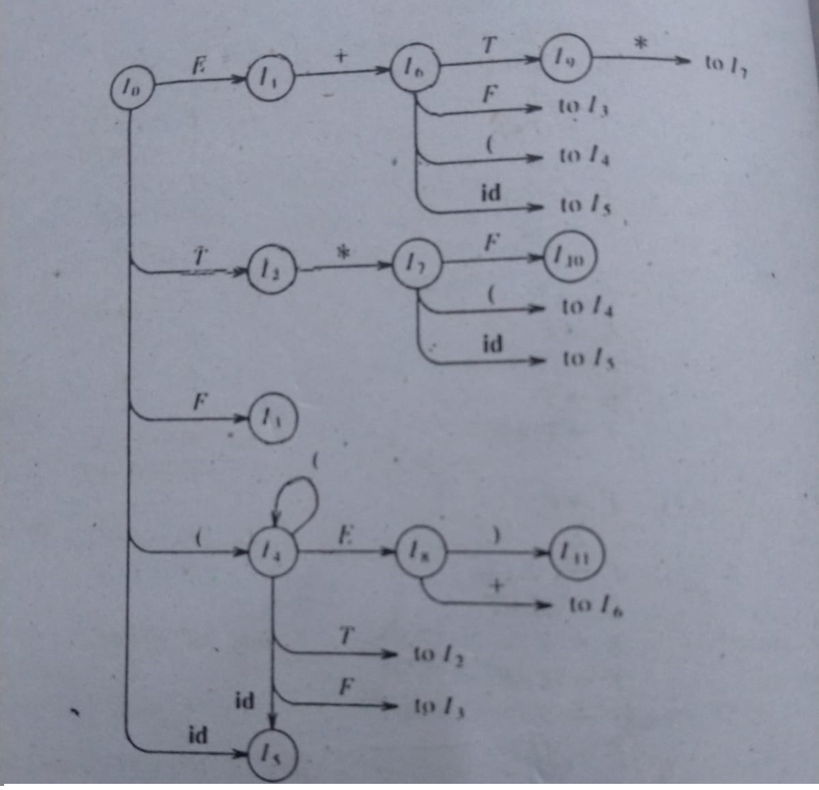

Slide 6
